Slide 1



DataBase Management of EQ3 Company
Submitted By:
Gaurav Manchanda
Narinder Pal Singh
Harjinder Singh
Naveen Chawla
Harman Singh

Slide 2
CONTENT
Introduction of EQ3 Company
ER Diagram
Tables Representaion and Normalization
CONSTRAINTS
Triggering Concept
Database
Migrate to Azure Cloud

Slide 3
EQ3 Company Introduction
Founded in 2001, EQ3 is a Canadian retailer and manufacturer committed to quality craftsmanship and design.
EQ3 promotes original design, domestic manufacturing, and a unique Canadian perspective on modern home furnishings and products.
EQ3 was established in Winnipeg under the direction of Peter Tielmann
EQ3 has since grown to become a vertically integrated chain of retail stores that champions innovation and quality furniture design for everyday life and for every home, no matter the size.

Slide 4
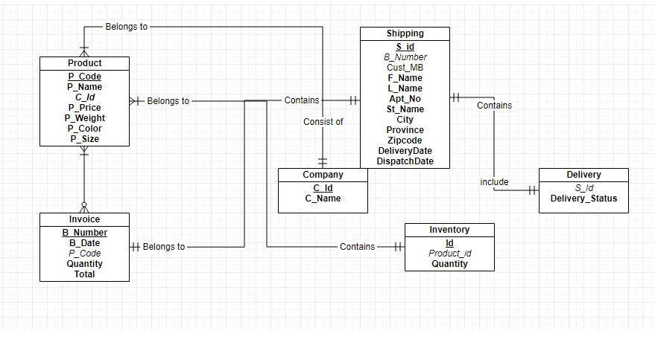
ER Diagram Representation

Slide 5
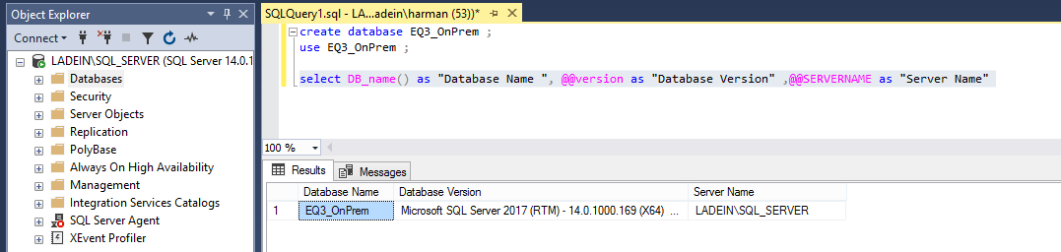
DATABASE AND SQL SERVER
SQL SERVER 2017
DATABASE: EQ3_OnPrem

Slide 6
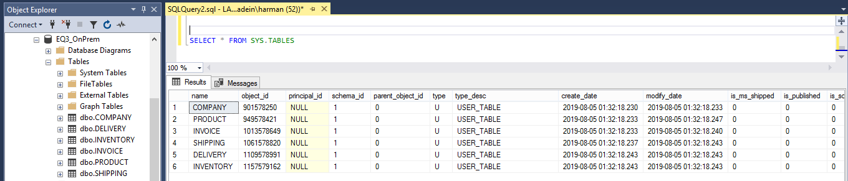
TABLES IN DATABASE

Slide 7
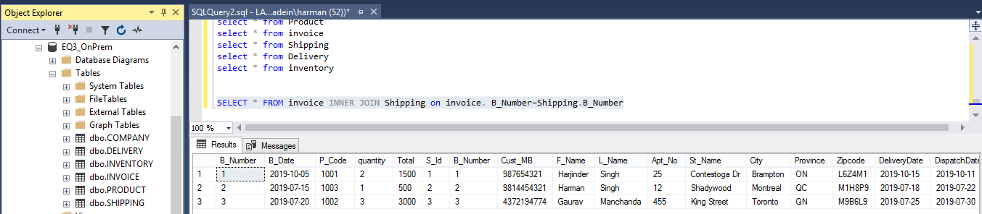
TABLE DATA REPRESENTATION

Slide 8
CONSTRAINT
PRIMARY KEY
create table Company(C_Id int primary key,C_Name varchar(50) UNIQUE);
FOREIGN KEY
ALTER TABLE Delivery ADD FOREIGN KEY (S_ID) REFERENCES Shipping(S_Id);
UNIQUE KEY
create table Company(C_Id int primary key,C_Name varchar(50) UNIQUE);
CHECK CONTRAINT
create table Product(P_Code int primary key CONSTRAINT CK_VAL CHECK(P_Code>1000)
NOT NULL CONTRAINT
create table Product(P_Code int primary key CONSTRAINT CK_VAL CHECK(P_Code>1000),P_Name varchar(50) not null,

Slide 9
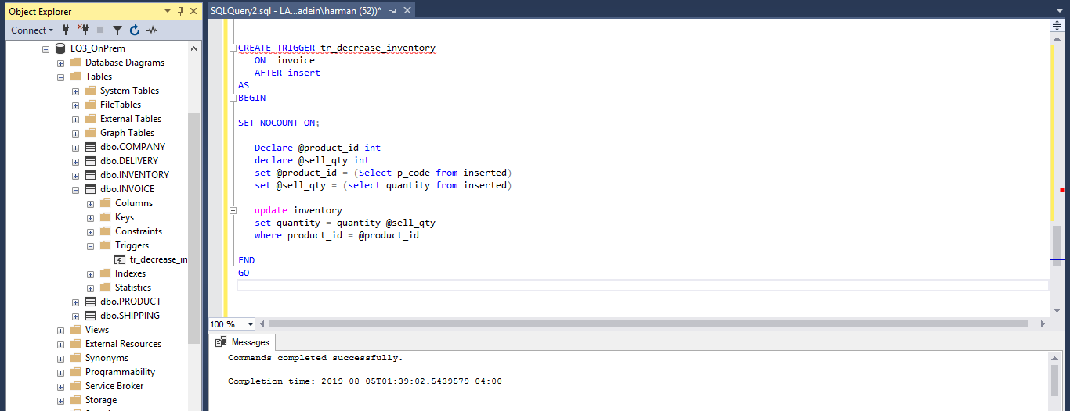
TRIGGERING

Slide 10
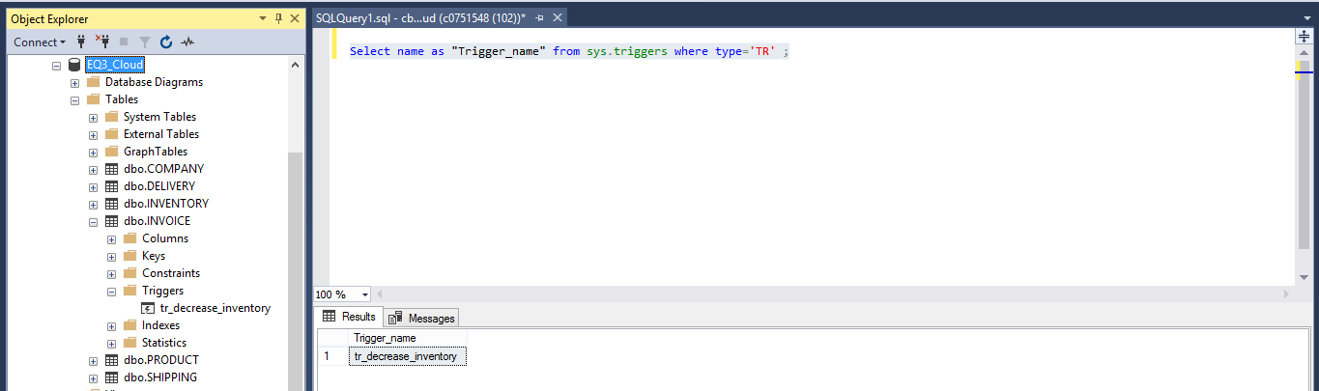
TRIGGERING CONT.

Slide 11
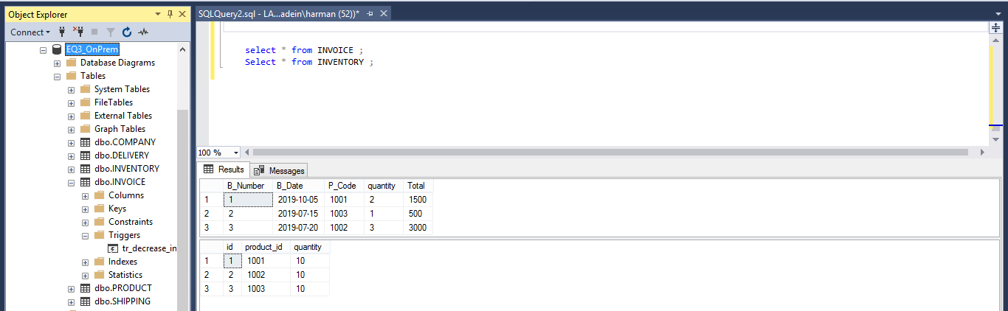
TRIGGERING CONT.

Slide 12


Slide 13
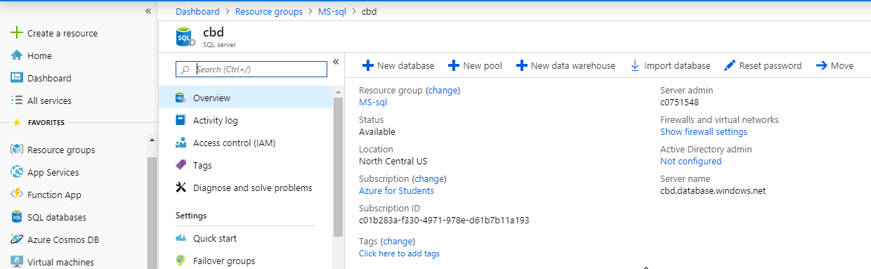
CREATING MS SQL ON AZURE CLOUD

Slide 14
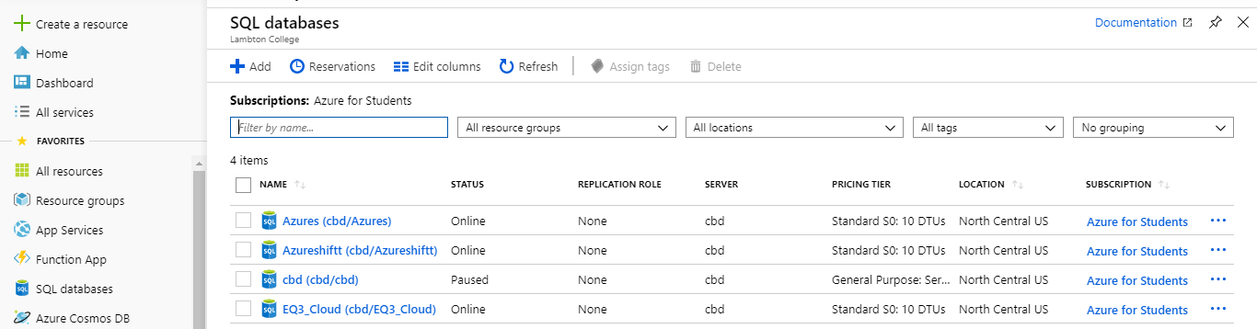
CREATING MS SQL ON AZURE CLOUD CONT..

Slide 15
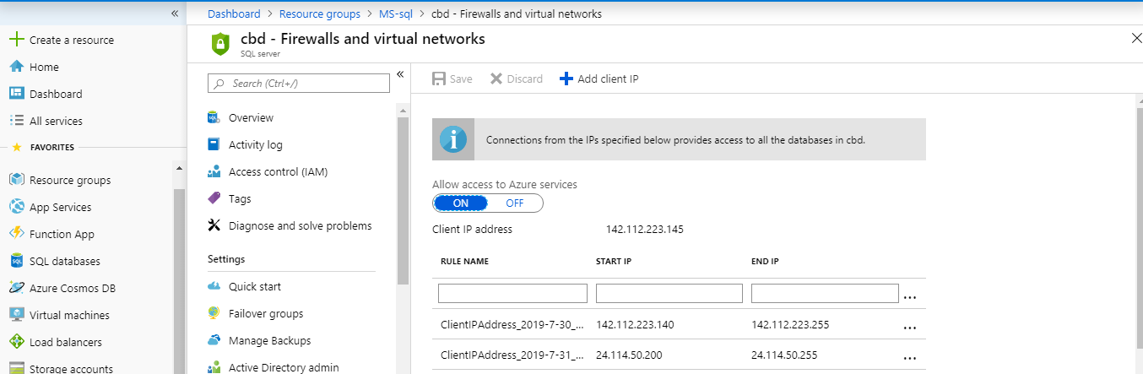
FIREWALL SETTING FOR AZURE CLOUD

Slide 16
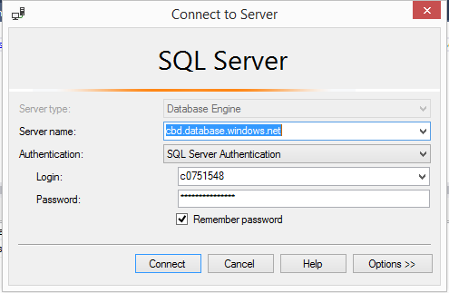
CONNECTION AZURE CLOUD FROM MANAGEMENT STUDIO

Slide 17
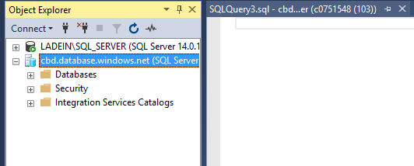
LOCAL AND CLOUD DATABASE

Slide 18
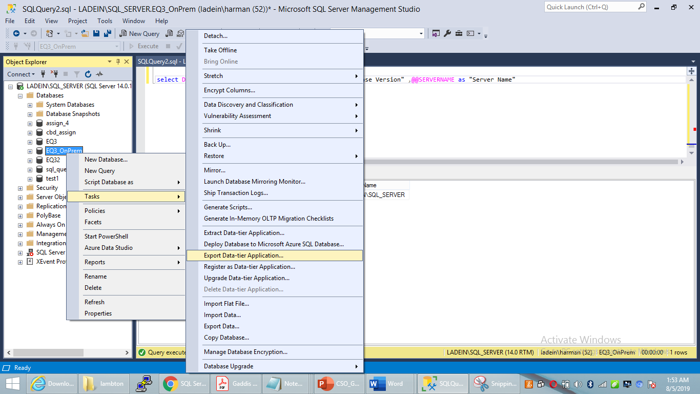
EXPORT LOCAL DATABASE

Slide 19
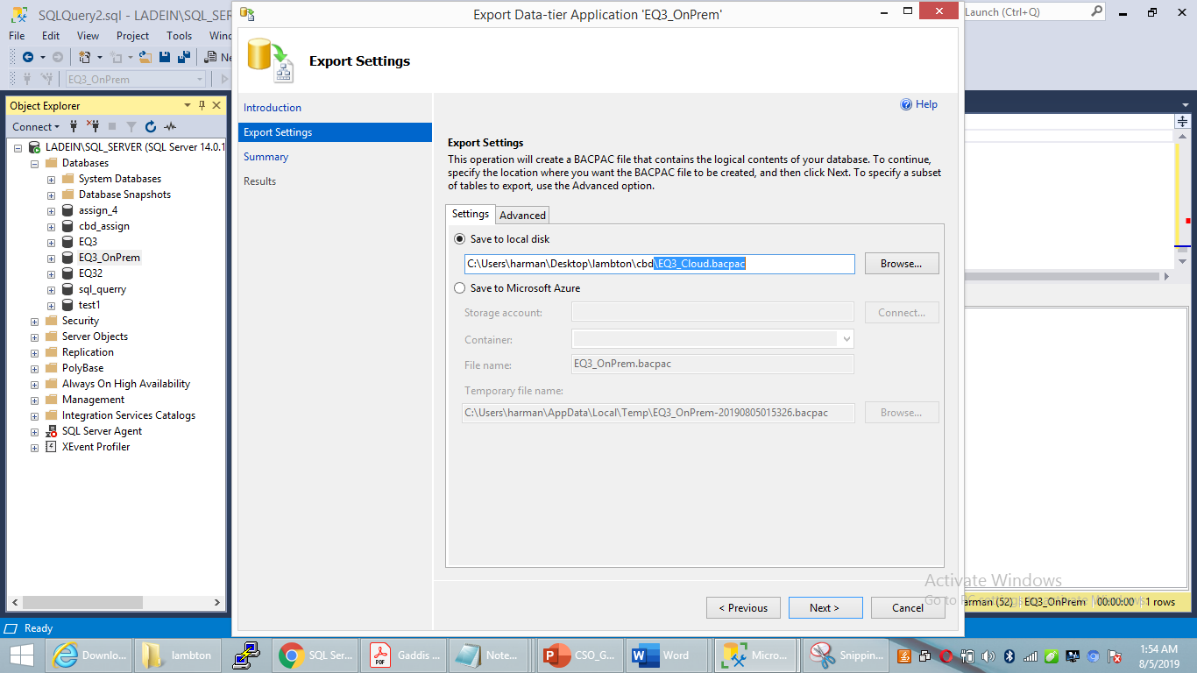
EXPORT LOCAL DATABASE CONT..

Slide 20
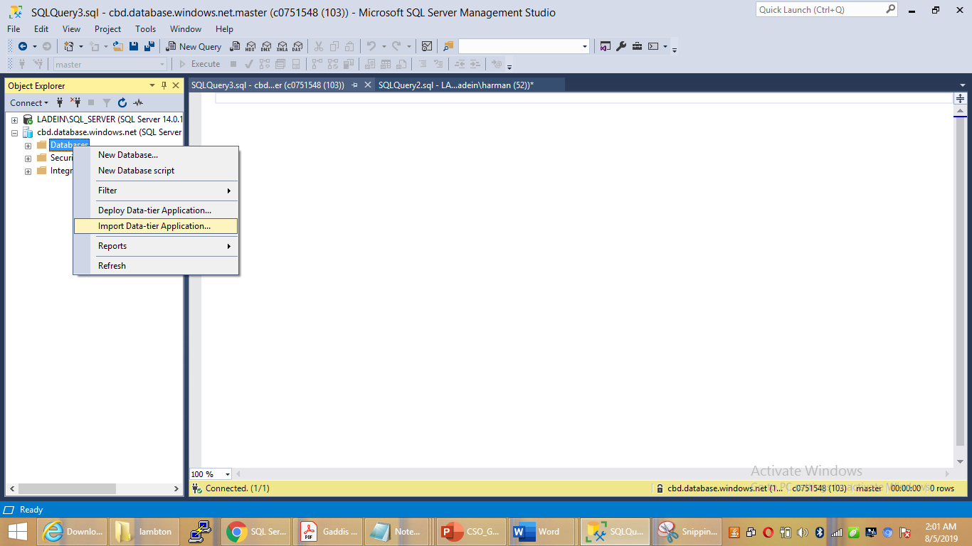
IMPORT DATABASE TO AZURE CLOUD

Slide 21
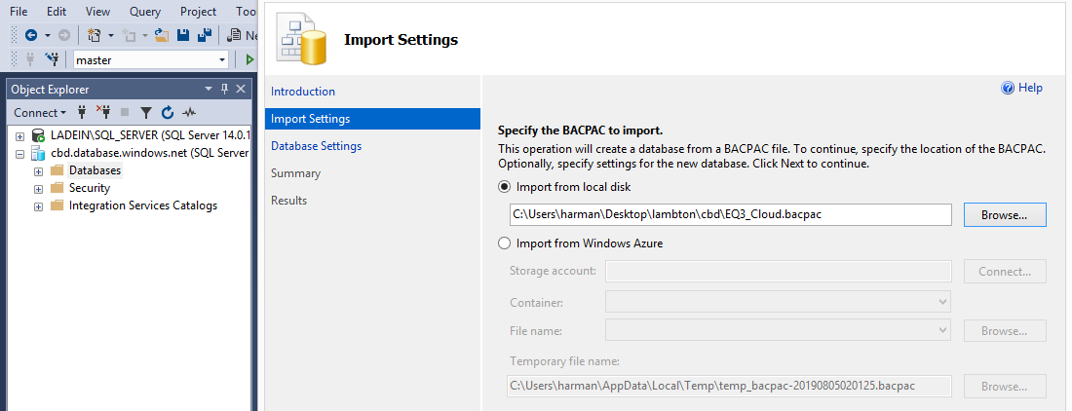
IMPORT DATABASE TO AZURE CLOUD CONT.

Slide 22
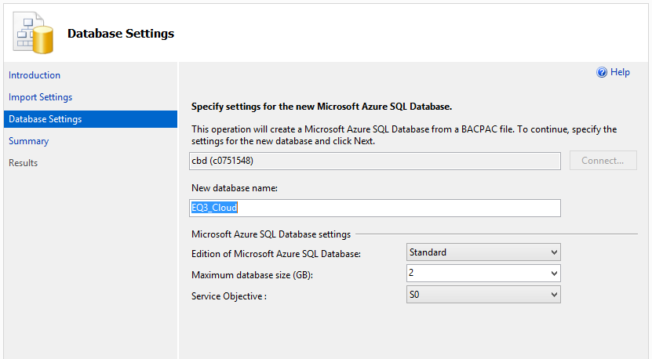
IMPORT DATABASE TO AZURE CLOUD CONT..

Slide 23
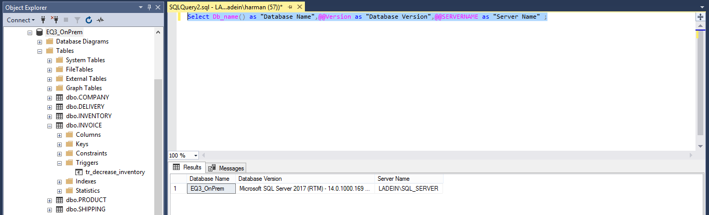
Validation
Local Database – EQ3_OnPrem

Slide 24
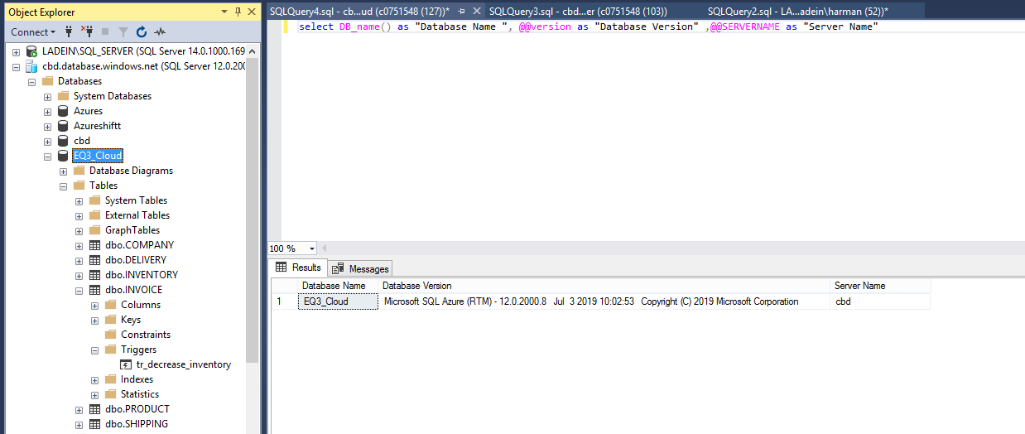
Validation Cont…
Cloud Database – EQ3_Cloud

Slide 25


